Slide 1
Methodology

Slide 2
Dataset
Data set information
Answer the following question
What
How
When
Why

Slide 3
Dataset: what to gather?
Data type:
Examples
Video
Traffic : CCTV footage
Emotion : face/movement footage
Sounds
Music Genre : Songs
Health : pulse rate
Documents
Emotion : Twitter/Facebook
Health : Profile of Patients

Slide 4
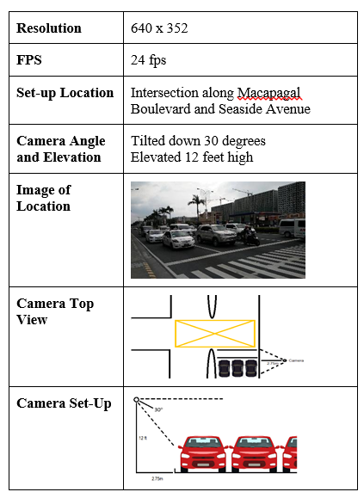
Dataset: How to gather data?
Example: Traffic Monitoring
Set-up
Location of data collection
Hardware to be used for data collection (if any)
specification
Hardware set-up during data gathering
E.g. angle and elevation

Slide 5
Dataset: How to gather data?
Example: Social Media Related Research
Data Source
Twitter
Facebook
Third Party Software for web mining (if any)

Slide 6
Dataset: How to gather data?
Example: Health Related Research
Data Source
From an organization
Internet/download
Digitized documents

Slide 7
Dataset: when to gather
Time Duration
Example
Traffic : During rush hours
Emphatic(for call center research related) : During peak calls
Date
Define the start date and end date of data gathering.
Specific Day (if there is)
Traffic: Monday to Friday to only
Example
Tweet Related Research
Define the years of data to be gathered

Slide 8
Dataset: why?
Justification of procedures in data gathering
Must be aligned in
answering the research question/s
Meeting the objectives
From previous studies

Slide 9
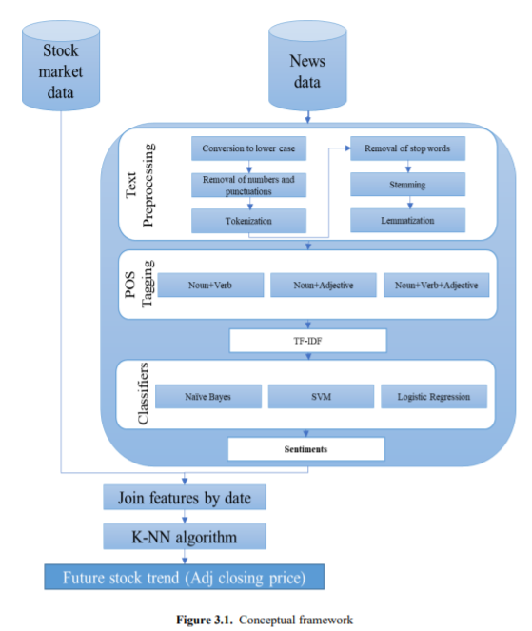
Procedures/experiment
Define the steps in doing the research
How data will be processed in building the model
Example
Stock Market Analysis (source: Sonam thesis)

Slide 10
Procedure experiment
Data Pre-processing
Data Cleaning
Data Enhancement
Model Creation
Type of Classifier
NN
KNN
SVM
Validation
10 folds?
How will you validate

Slide 11
Model testing
Dataset
Profile
Criteria
Define
formula

Slide 12
Summary
Content of Methodology
Dataset
Procedure
Model Testing

